Slide 1

Holiday Planner Your Virtual traveling Assistant
Nicolae Moroșan
Laurențiu Stăncioiu
- ITSG -

Slide 2

Intro & Motivation
Chaotic planning process
A lot of time wasted
Lack of accurate information
Too many tools on the market, yet none targeted

Slide 3

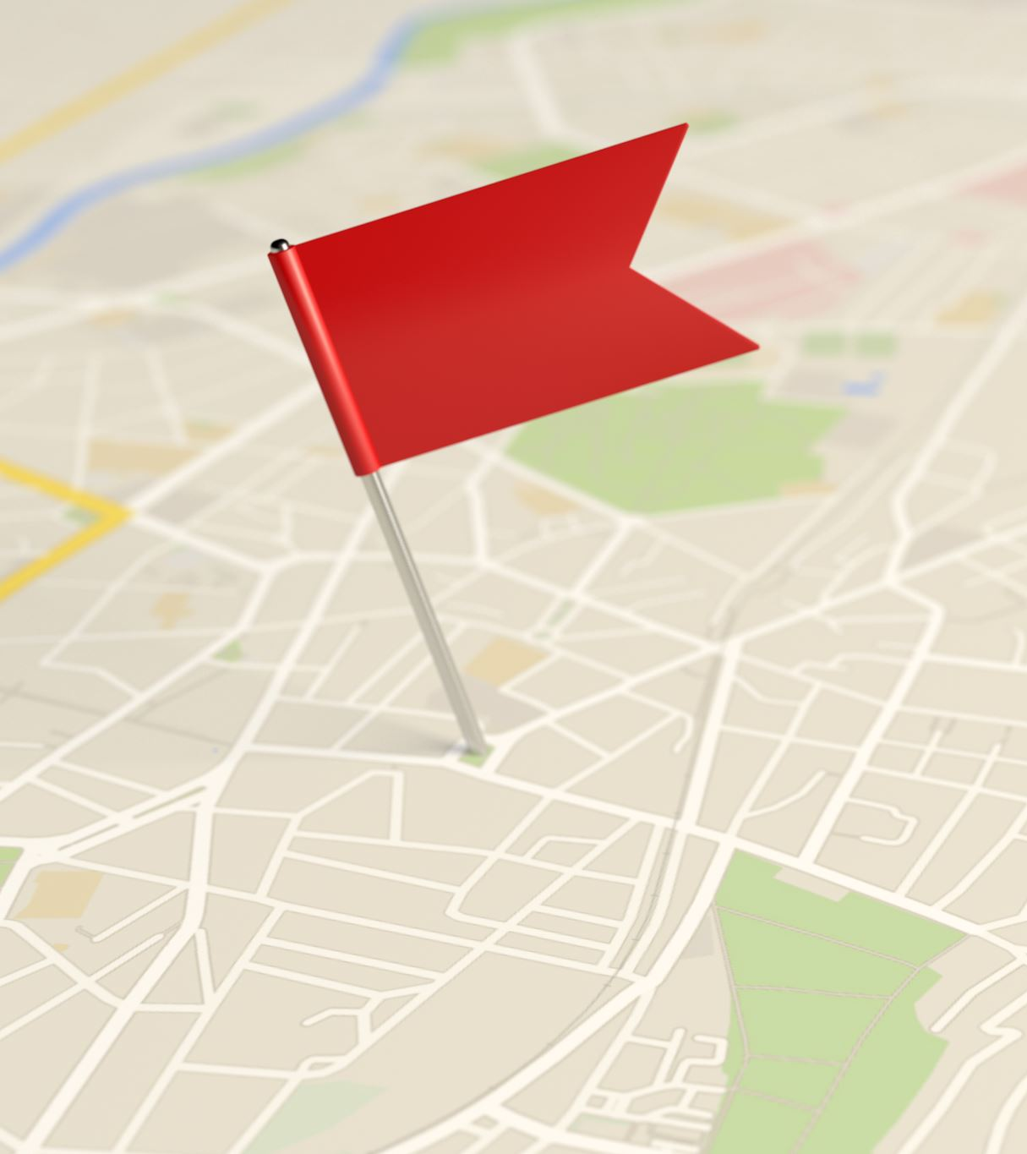
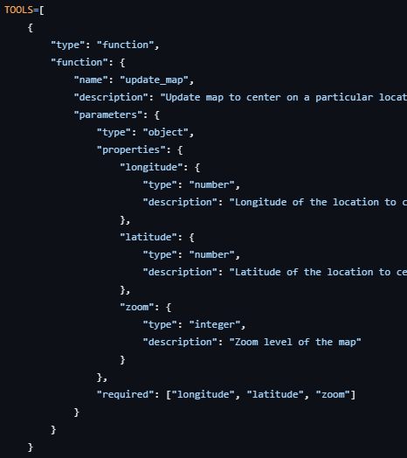
Model (Purely unsupervised -> semi supervised)
The use of control tools - functions
Examples:
update_map
add_marker
search_wikipedia

Slide 4


Other key functionalities
Record voice (beta)
Map (beta)

Slide 5








Tech Stack

Slide 6

Future plans
Attach documents and pictures

Slide 7

Q & A

Slide 8

Let’s proceed to live demo

